Slide 1
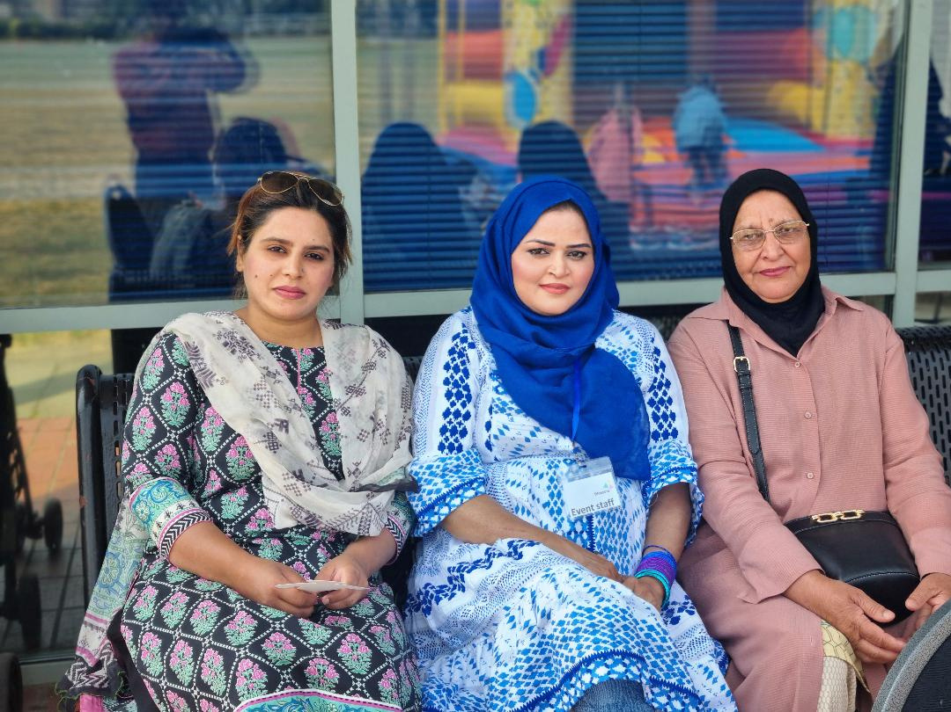

Mental Health Project
South Asian
Women in Newham

Slide 2
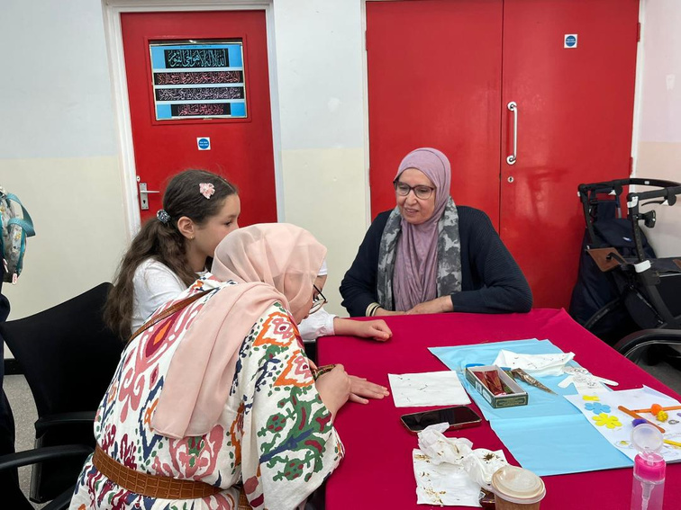
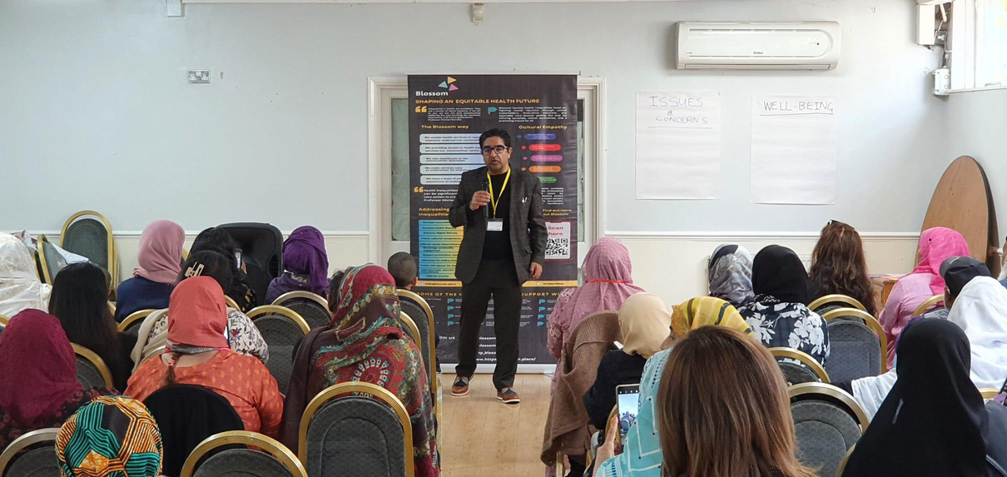
In the exploration of mental health and cultural perspectives within Newham's South Asian community, 450 women bravely shared their stories. From ages 18 to 91, their insights form a mosaic of challenges and resilience.
This brief encapsulates the vibrant voices that echo throughout, amplifying the call for targeted interventions. It's a collective pledge to foster a more inclusive and empathetic approach to mental well-being. Our deepest gratitude to the women who illuminate this path toward transformative initiatives.
PREFACE

Slide 3
1.
  Dynamic Volunteer Team
4.
  Manor Park Saifi Centre Meetings
Blossom engaged 12 women volunteers from South Asian communities, each with lived experiences, cultural competence, and respect within their communities.
The dedicated volunteer team met weekly at the Saifi Centre in Manor Park, fostering a supportive environment for feedback, idea exchange, and overcoming challenges.
2.
  Community Connectors
5.
  Collaborative Group Sessions
OUR TEAM
Regular gatherings at the Saifi Centre facilitated constructive discussions, skill-sharing, and collective problem-solving to enhance the effectiveness of outreach efforts.
Volunteers had direct access to faith and community organizations, establishing a vital link between Blossom and the heart of South Asian communities.
3.
6.
  Ongoing Support and Empowerment
  Strategic Outreach Locations
Blossom's commitment to continuous improvement and providing a supportive community for volunteers underscored the organisation's dedication to addressing diverse mental health needs within South Asian communities in Newham.
Targeted interactions were conducted in familiar spaces like shopping centers, beauty salons, and community events (weddings, birthdays) where the volunteers were well-known and trusted.

Slide 4
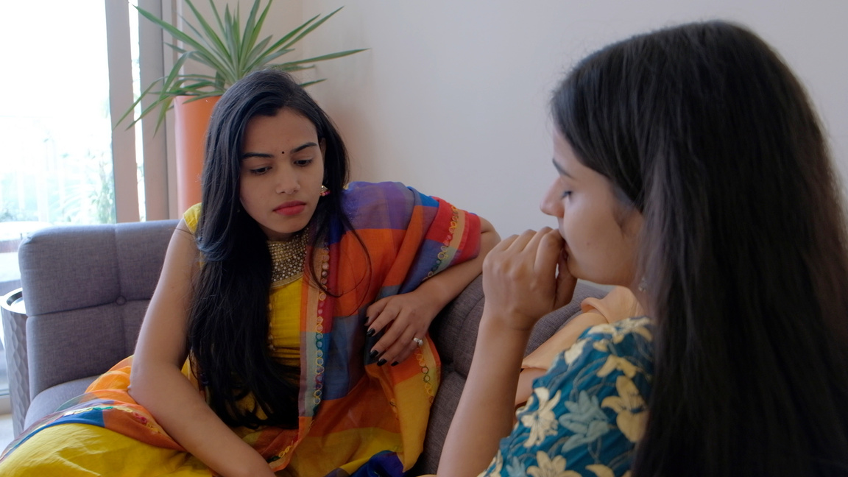

Conducted a comprehensive mental health survey targeting 450 South Asian women in Newham, spanning diverse age groups from 18 and above.
  Obtained insights on the impact of cultural background, historical influences, and stigma on mental health perceptions and service utilization.
  Aimed to understand the challenges and perceptions related to mental health within this community, with a focus on cultural perspectives and awareness.
THE SURVEY - WHAT WE DID
  Collected diverse perspectives on unaddressed mental health topics, providing valuable input for future interventions.
  Explored personal information, mental health definitions, past support experiences, and barriers to accessing mental health services.

Slide 5
Targeted Demographic
Gender-specific
Challenges
The survey was specifically conducted for South Asian women in Newham, acknowledging the intersection of cultural, gender, and mental health factors unique to this community.
Cultural Relevance
The survey aimed to capture and address mental health challenges specific to South Asian women, considering societal expectations, cultural roles, and gender dynamics.
Tailored interventions were designed to be culturally relevant, recognizing the diverse backgrounds, languages, and traditions within the South Asian female community.
THE SURVEY - WHAT WE DID
Community
Empowerment
Building Trust
and Inclusivity
Visibility of
Mental Health Issues
Language Accessibility
South Asian women were provided with a platform to express their mental health concerns, share experiences, and contribute to the development of supportive interventions.
By engaging directly with South Asian women in familiar community spaces, Blossom sought to build trust, inclusivity, and a sense of belonging, encouraging open discussions around mental well-being.
The survey focused on addressing the potential invisibility of mental health issues within the South Asian women community, bringing them to the forefront and validating their unique experiences.
Blossom ensured language accessibility by providing survey materials and support in multiple languages, recognizing linguistic diversity within the South Asian community.

Slide 6



Focused on the role of community organisations in enhancing mental health support for Asian women in Newham.
  Sought suggestions for improvements in mental health services to better serve the needs of the Asian community in Newham.
  Investigated interest in and preferences for mental health workshops or support groups tailored for Asian women.
  Engaged participants representing various generations, ethnicities, and experiences, ensuring a holistic understanding of mental health dynamics.
THE SURVEY - WHAT WE DID
  Explored challenges related to cultural differences and misconceptions within the community that might hinder access to mental health services.
  The survey outcome will inform targeted and inclusive strategies, contributing to the development of a more supportive and understanding mental health environment within the South Asian community in Newham.

Slide 7
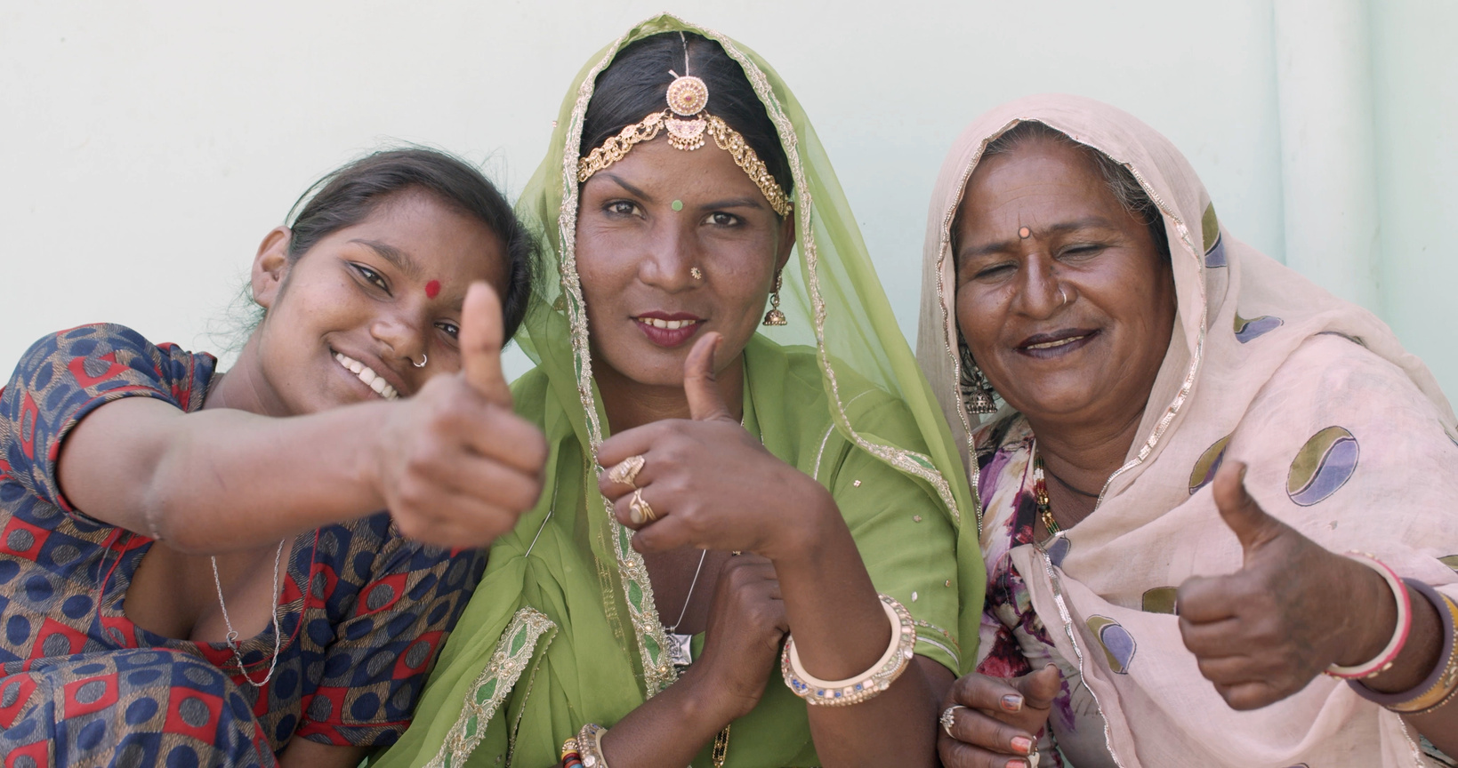
Blossom conducted this survey specifically for South Asian women in Newham to ensure a targeted and culturally sensitive approach. The focus on South Asian women aimed to address the unique intersection of cultural, gender, and mental health factors within this community. By tailoring the survey to their experiences
THE SURVEY - WHAT WE DID
Enhanced Visibility
Address the potential invisibility of mental health issues within this community and bring them to the forefront, validating the experiences of South Asian women and acknowledging their unique perspectives.

Slide 8
PROGRAMME DELIVERY
Gurdwara Health Event
Gurdwara Guru Nanak Birthday
Local South Asian Shops
Milad Un Nabi The Prophet Muhammad’s Birthday
Diwali Programme East Ham Hindu Temple
Hairdressing and Beauty Salon’s
Newham Community Event
Green Street Queens Market Event
16 Togetherness Cafe’s in the Saifi Trust
Ibrahim Mosque Madrassah Classes
2 Music Programmes for the South Asian Communities
House to House Visits
Household equipment, usually made of wood, metal, plastics,
marble, glass, fabrics, or related materials and having a variety
of different purposes.

Slide 9
THE LANGUAGES WE DELIVERED IN AND
HOW WE REACHED THE COMMUNITY
Hindi
Tamil
Urdu
Punjabi
Malayalam
Bengali
Pahari
Farsi
Gujarati
Pothohari
Pashto
IDEA

Slide 10
450 South Asian Women from Newham
Well-being and Mental Health Definitions
Diverse responses reflecting personal perceptions, with common themes of emotional balance, resilience, and fulfillment.
DEMOGRAPHICS & FINDINGS
Residential Location
Diverse representation from various areas in Newham, ensuring a broad range of perspectives.
Sense of Belonging
in Newham
Yes: 212 participants
No: 238 participants
Levels of Support
High level of perceived support from community, family, and friends: 120 participants (26.7%)
Moderate support: 150 participants (33.3%)
Low support: 180 participants (40%)

Slide 11
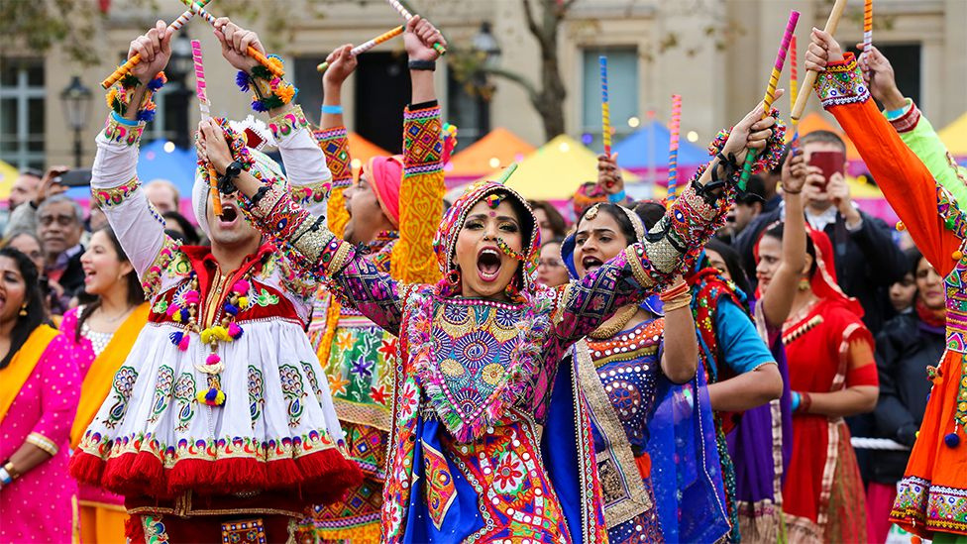
DEMOGRAPHICS & FINDINGS
Language and Education
Cultural Influence on Mental Health
Limited proficiency in English reported by 30%, while 30% expressed varying levels of proficiency.
80% acknowledged that their cultural background influenced their perception of mental health and well-being.

Slide 12
Age Distribution
Length of Residency in Newham
18-25 years: 65 participants (14.4%)
26-35 years: 100 participants (22.2%)
36-45 years: 70 participants (15.6%)
46-55 years: 75 participants (16.7%)
56-65 years: 80 participants (17.8%)
66+ years: 60 participants (13.3%)
Less than 5 years: 50 participants (11.1%)
5-10 years: 70 participants (15.6%)
11-20 years: 120 participants (26.7%)
21+ years: 210 participants (46.7%)
GP Registration
and Health
DEMOGRAPHICS & FINDINGS
Last visited a health professional or GP within the past year:
120 participants (26.7%)
Visited for general health concerns annually: 50 participants (11.1%)
Historical and Colonialism Influence on Mental Health
Cultural Barriers
and Language
Language barriers affected access for 131 participants, with many unable to overcome, and some overcoming them through informal community support
Registered with a GP in Newham: 300 participants (66.7%)
Not registered: 150 participants (33.3%)
30% believed that historical events moderately to very strongly influenced mental health issues in their community.

Slide 13
Past Mental Health Support
Awareness of Mental Health Services
Sought mental health support in Newham: 120 participants (26.7%)
Types of support: Counseling (80 participants), therapy (30 participants), support groups (10 participants).
121 Learned about mental health services from various sources, including community events (50%), online resources (30%), and GP referrals (20%
Stigma and Discrimination
191 participants reported encountering stigma or discrimination related to mental health within their community or in Newham.
Accessing Mental Health Services
Hesitancy
Generally hesitant to discuss mental health concerns with healthcare professionals, with only 23% feeling understood in terms of their cultural background and needs.
Impact of Stigmatization
DEMOGRAPHICS & FINDINGS
Overall negative experiences reported, with most encountering barriers related to limited awareness, stigma, and cultural differences.
Fear of stigmatization impacting willingness to seek mental health services reported by 312 participants (69.3%)

Slide 14
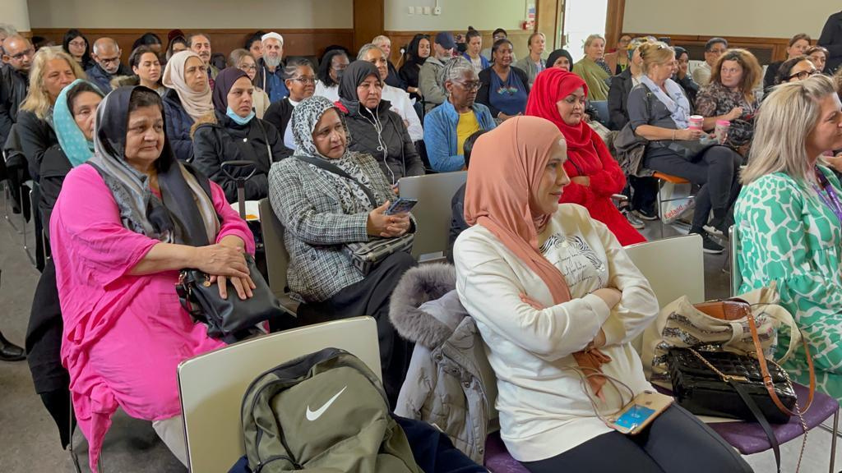
Not Being Registered with a GP:
  33.3% of participants reported not being registered with a GP in Newham.
  Lack of GP registration has resulted in limited access to regular healthcare services.
  This has impacted on overall health and well-being due to delays in accessing necessary medical interventions.
  Absence of regular check-ups and timely medical advice has contributed to increased stress and health-related concerns.
  Addressing barriers to GP registration is crucial for ensuring comprehensive healthcare and promoting holistic mental well-being within the South Asian women community in Newham.
FINDINGS
Barriers in Accessing Mental Health Services
Negative experiences and barriers has led to a lack of timely and appropriate mental health support, impacting emotional well-being.
Cultural Barriers and Language
Language barriers have hindered effective communication with healthcare professionals and limit access to mental health resources, potentially causing frustration and stress.

Slide 15
Impact of Stigmatisation:
The fear of stigmatisation has had a significant barrier to these women seeking mental health services, potentially leading to untreated mental health issues.
Challenges in Communication with Healthcare Professionals:
Hesitancy in discussing mental health concerns with healthcare professionals may lead to unaddressed issues and hinder the development of effective treatment plans.
Stigma and Discrimination
Encountering stigma or discrimination within the community has contributed to feelings of isolation, shame, and reluctance to seek mental health assistance.
FINDINGS
Cultural Influence on Mental Health
While cultural background can provide a support system it also contributes to unique stressors and expectations, impacting on mental health perceptions.
Historical Influence on Mental Health
Historical events influencing mental health issues has contributed to collective trauma or cultural factors that affect mental well-being.
Limited Proficiency in English and Digital Skills:
Limited proficiency in English and digital skills has create d barriers to accessing mental health information and resources, potentially leaving individuals feeling uninformed or isolated.

Slide 16
Cultural Sensitivity Gap:
Insufficient cultural competence among existing mental health services, leading to a lack of resonance with the community's cultural nuances.
Absence of tailored interventions that address the specific needs and challenges faced by South Asian women in Newham.
Limited External Awareness Channels:
Lack of widespread external efforts to raise awareness about mental health resources within the community.
Absence of targeted campaigns, resulting in a significant portion of the community remaining unaware of available support.
FINDINGS
Language Barriers and Communication Hesitation:
Language barriers acting as a deterrent, making it challenging for these women to access and communicate with existing mental health services.
Hesitation to discuss mental health concerns due to concerns about being misunderstood, especially in the context of cultural backgrounds.
Historical Stigmatization:
Lingering historical stigmatization and societal attitudes towards mental health within the broader community.
Perception of mental health challenges as taboo, discouraging open discussions and help-seeking behavior.

Slide 17
External Support Disconnection:
Disconnect between external mental health support services and the lived experiences of these women, making the services seem detached and irrelevant.
Perceived inadequacy in catering to the real-world challenges and cultural contexts faced by the South Asian women community in Newham.
Scarce Community Engagement Efforts:
Limited efforts to engage directly with the community, resulting in a lack of visibility and connection with existing mental health programs.
Insufficient presence at community-centric locations and events where these women frequent, further contributing to feelings of isolation.
FINDINGS
Ignorance of Specific Needs:
Failure to acknowledge and address the specific mental health needs of South Asian women in Newham.
Lack of programs that consider the intersectionality of factors such as culture, age, and language, leading to a sense of being overlooked.
Limited Accessibility and Reach:
Limited accessibility of mental health services, both in terms of physical locations and online platforms, restricting the community's ability to seek help.
Insufficient efforts to reach out to women who may be isolated or have restricted access to information about mental health resources.

Slide 18
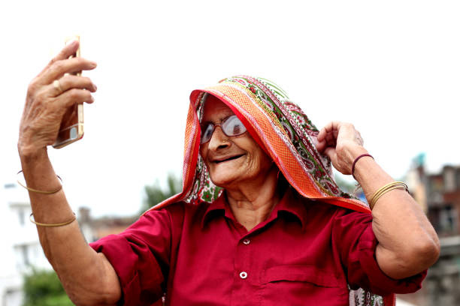

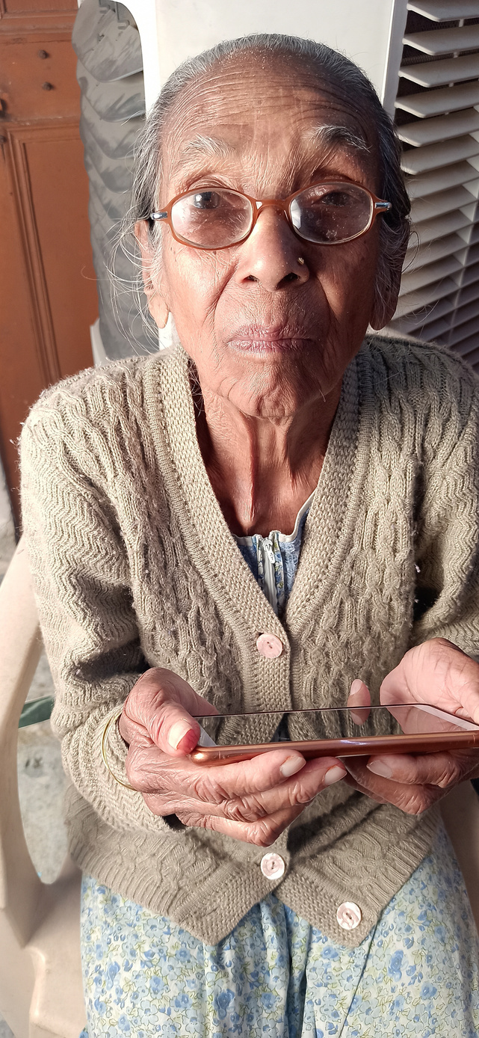
FINDINGS
Inadequate Representation and Inclusivity:
Lack of representation and inclusivity in existing mental health initiatives, making these women feel marginalized and overlooked.
Absence of programs that actively address the unique challenges faced by South Asian women, leading to a sense of neglect.
Limited Trust in External Support:
Lack of trust in external mental health support systems, possibly stemming from historical neglect or negative past experiences.
Perceived insensitivity or lack of understanding from external service providers, hindering the development of trustful relationships.

Slide 19
Tailored Interventions for South Asian Women:
Blossom designs interventions that specifically target the mental health needs of South Asian women, acknowledging the intersectionality of factors such as culture, age, and language that influence their experiences.
Cultural Competence and Understanding:
Blossom recognizes and values the rich cultural diversity within the South Asian community, ensuring that its programs are culturally competent and resonate with the unique experiences of these women.
Blossom, with its unique approach and tailored strategies, stands as a beacon of hope to address the specific challenges faced by South Asian women in Newham, fostering a community-centered and culturally sensitive environment.
RECOMMENDATIONS
Celebration of Cultural Events:
By actively participating in cultural and religious events, Blossom not only celebrates diversity but also integrates mental health discussions into the community's cultural fabric, reducing stigma and promoting open conversations.

Slide 20
Community-Centric Engagement:
Unlike generic approaches, Blossom actively engages with the community deep within the heart of their neighborhoods, ensuring a direct and meaningful connection.
Direct Outreach in Native Languages:
Blossom addresses language barriers by providing support and understanding in multiple languages such as Urdu, Hindi, Punjabi, Tamil, Malayalam, Gujarati, Bengali, Pothwari, Pohari, Pashtu, and Farsi, ensuring effective communication and comprehension.
Innovative Strategies and Direct Feedback:
Blossom involves women volunteers from within the South Asian communities who have lived experiences, cultural competence, and respect within the community. These volunteers actively gather feedback, ensuring the programs remain dynamic and responsive to the community's evolving needs.
RECOMMENDATIONS
Direct Engagement in Community Spaces:
Blossom's direct engagement within community spaces creates a comfortable and accessible environment for women to share their experiences, fostering trust and a sense of belonging.
Weekly Meetings for Collective Feedback:
Weekly meetings of volunteers provide a platform for collective feedback and collaborative problem-solving, overcoming challenges faced by the South Asian women community in accessing mental health resources.
Targeted Awareness Campaigns:
Blossom implements targeted promotional campaigns, leveraging community events and gatherings, ensuring that information about mental health services reaches a broader audience within the South Asian community.

Slide 21
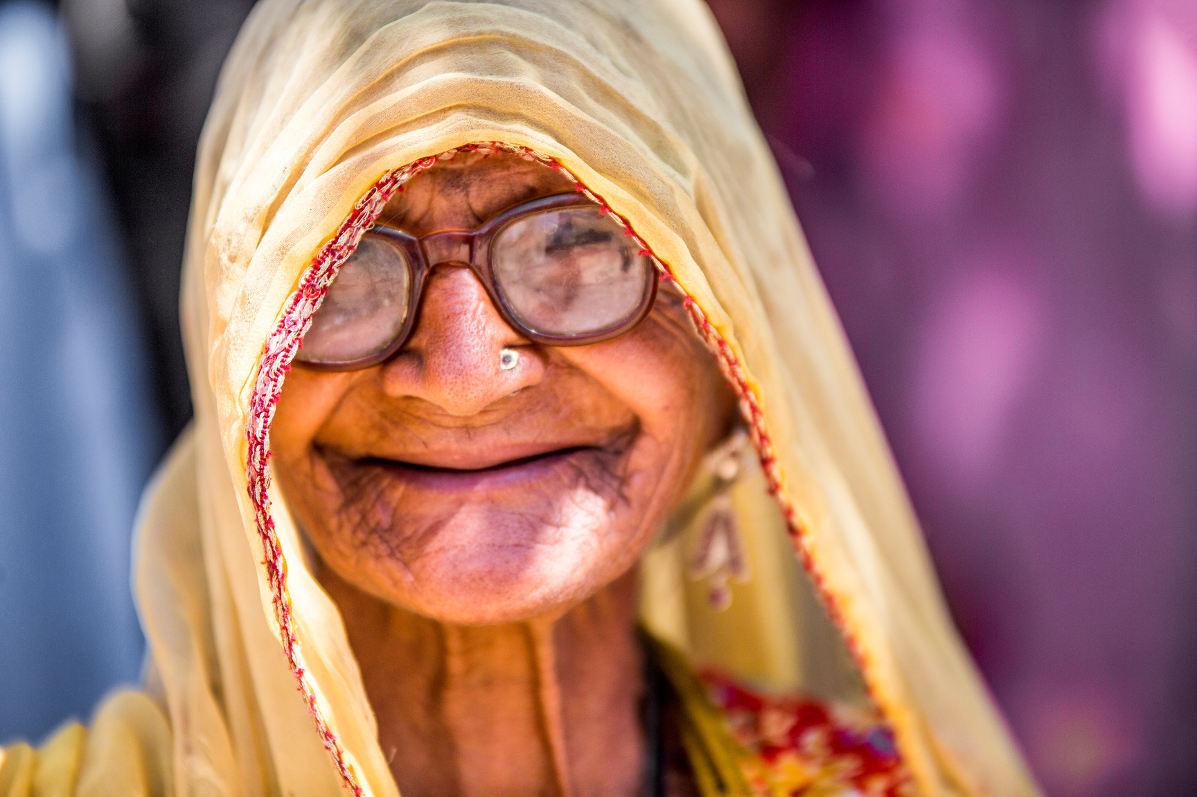
Empowering Through Success Stories:
Blossom actively encourages participants to share success stories, creating a positive narrative around mental health and inspiring others to seek support
In essence, Blossom's unique and community-centric approach, including the Togetherness Café, positions it as the ideal partner to address the challenges faced by South Asian women in Newham, providing them with tailored, accessible, and culturally sensitive mental health support. Blossom's commitment to creating a real sense of belonging and worth through the Togetherness Café is truly distinctive.
Comprehensive Evaluation for Continuous Improvement:
Blossom conducts a thorough program evaluation, taking into account attendance rates, feedback, and self-reported changes in mental health. This data-driven approach ensures continuous improvement and adaptability to the community's evolving needs.
RECOMMENDATIONS

Slide 22
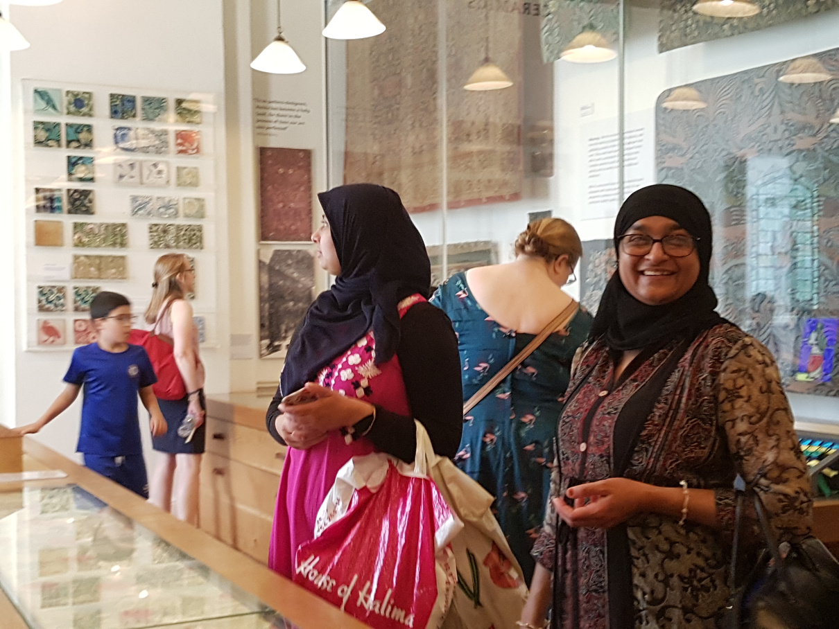
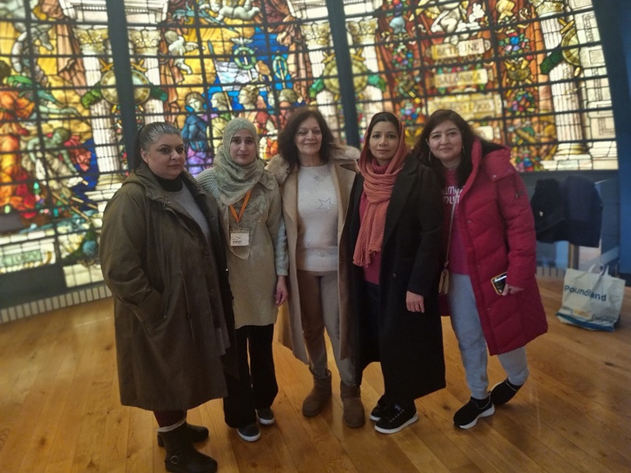
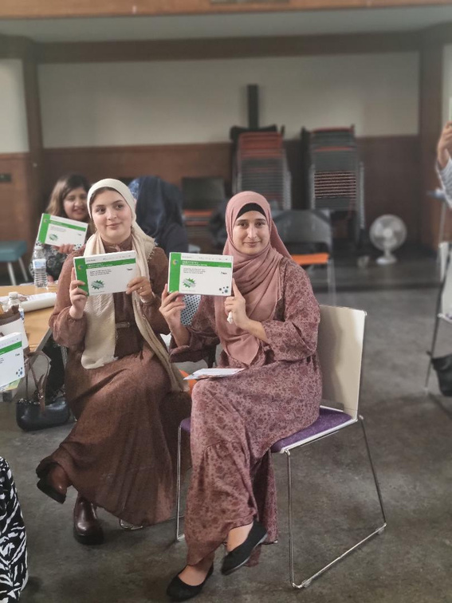
TESTIMONIALS
"Our history is a part of us, but it doesn't define us. Understanding its impact on mental health helps us rewrite our own story."
"Language shouldn't be a barrier to mental health. Speaking in my mother tongue makes the journey to healing much smoother."
"Not just a survey; it's a call for change. Letting our voices echo paves the way for a mental health landscape that truly understands us."

Slide 23
Hello, I am Aisha, a young South Asian woman born and raised in the UK. I wanted to share my experience with Blossom's Mental Health Programme in Newham. The Togetherness Café sessions organized by Blossom have been instrumental in navigating the complexities of my dual identity.
Blossom's inclusive approach to the Mental Health Programme and the insightful survey they conducted allowed for a nuanced exploration of the unique challenges faced by young South Asian women like me. The workshops and support groups provided a safe and empowering space for open conversations, addressing mental health concerns specific to our demographic.
The program not only acknowledged but actively nurtured the mental well-being of young South Asian women. Blossom's dedication to creating a supportive community and fostering empowerment has made a significant impact on my personal journey and the experiences of others in similar situations.
MY STORY

Slide 24
In the vibrant tapestry of Newham, I, Mrs. Kapoor, found myself silently navigating the complexities of mental health. A woman in her 60s with an Indian heritage, I grappled with unspoken struggles, encumbered by the weight of cultural stigma that shrouded these issues.
Then came Blossom, a lifeline in the form of the Mental Health Programme for Asian Women in Newham. As I entered the Togetherness Café sessions, a warmth enveloped me, and I felt seen and heard. What set Blossom apart was its understanding of my native language, Hindi. This simple yet profound detail broke down barriers that had kept me silent for so long.
Blossom, through its inclusive survey, sought to unravel the unique challenges of South Asian women like me. The survey was more than just questions; it was a platform for my voice to be acknowledged and understood.
Week after week, the impact became tangible. The stigma, which had been a heavy cloak, began to dissipate. Workshops and support groups offered insights and tools tailored to our cultural context. Blossom became my guide, equipping me with the resilience to manage my mental health and, more importantly, fostering a community where I felt not just supported but empowered.
My journey with Blossom isn't just a personal one; it mirrors the transformative impact on the wider community. By embracing our cultural nuances, dismantling language barriers, and challenging stigma, Blossom has sown seeds of resilience, connection, and support in the very fabric of Newham.
MY STORY

Slide 25
From Bharti's Perspective: 27 Years of Community Dedication
As someone deeply rooted in the Tamil community, my journey with Blossom's Mental Health Programme has been nothing short of transformative. Over the span of 27 years, my involvement in community service has evolved alongside the changing dynamics and needs of the Tamil population in Newham.
When Blossom introduced the Mental Health Programme, it felt like a beacon of hope and an opportunity to address unspoken challenges within our community. Being a part of the project allowed me to channel my passion for community service into a space where mental health and cultural understanding intersect.
From the Togetherness Café sessions to the tailored workshops, Blossom's approach resonated with the ethos of preserving cultural identity while embracing the diverse experiences of Tamil individuals. The survey conducted within the community became a powerful tool for amplifying our voices, shedding light on nuanced mental health challenges that had often been overlooked.
The openness and inclusivity of the programme fostered a sense of belonging that transcended generational and cultural gaps. It was heartening to witness individuals, especially the youth, engaging in conversations about mental health with newfound confidence.
Through my involvement, I can see the positive impact Blossom's initiatives will have d on breaking down stigmas and creating a more supportive environment. The collaborative efforts with fellow volunteers and community members will solidify our shared commitment to enhancing mental well-being within the Tamil community.
As I reflect on my journey with Blossom, I am filled with gratitude for the platform it has provided to amplify the voices of the Tamil community. The programme's holistic approach aligns with my core belief that community well-being is intertwined with mental health, and together, we can continue to foster resilience, understanding, and unity.
VOLUNTEERS STORY

Slide 26

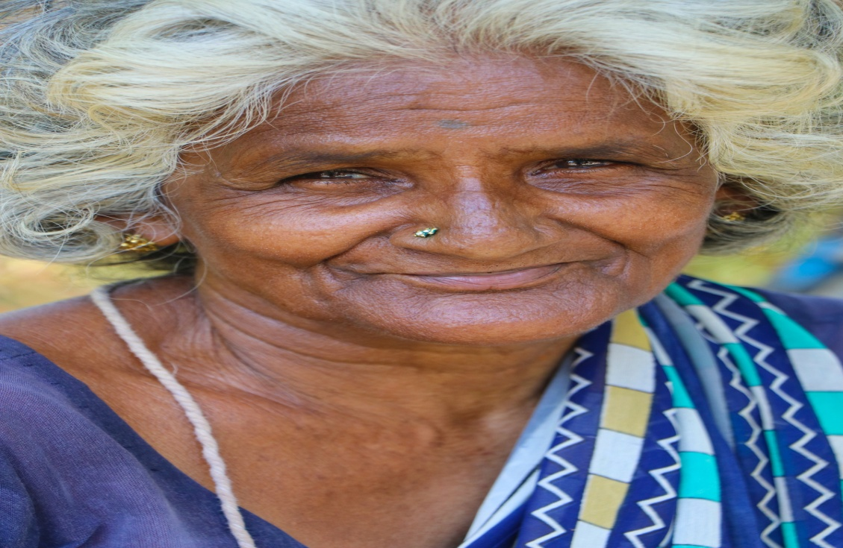


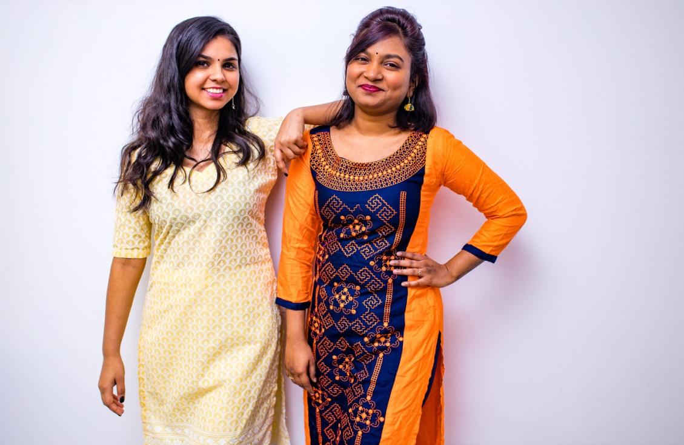
Thank you
With a dedicated team, a strong track record, and a clear market demand, Rimberio is poised for significant growth.

